Slide 1
10Pearls Data Science Project: Telco Customer Churn
September 5, 2024

Slide 2
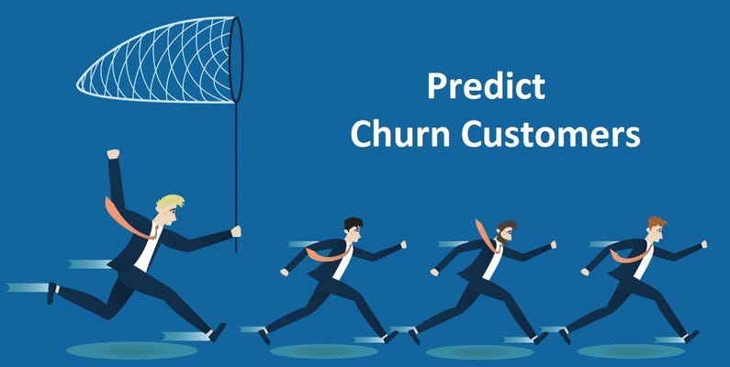
Overview
Analyse the “Telco Customer Churn” dataset.
Identify patterns which were precursors for customer churn.
Develop a machine learning model to predict churn.

Slide 3
Understanding the problem
Data Details
Churn
Predictions
The dataset consists of a number of details about each customer like:
Tenure
Monthly Charges
Dependents
Gender
Contract
And more…
We are provided information on whether certain customers churned or not.
We need to figure out patterns in churning.
Define solutions to prolonged churn.
Compare and choose the best model for predicting this churn and launch it as a web application.

Slide 4
Project objective:
Find out reasons for customer churn and predict future churn.

Slide 5
Module 1: Python for Data Analysis

Slide 6
Technologies
Python
Programming Language of choice
Pandas
Library for data handling
Data preprocessing capabilities
Matplotlib
Main data visualization library
Seaborn
Data visualization for more complex and prettified plots
Scikit-learn
Library for Machine Learning
Data processing capabilities

Slide 7
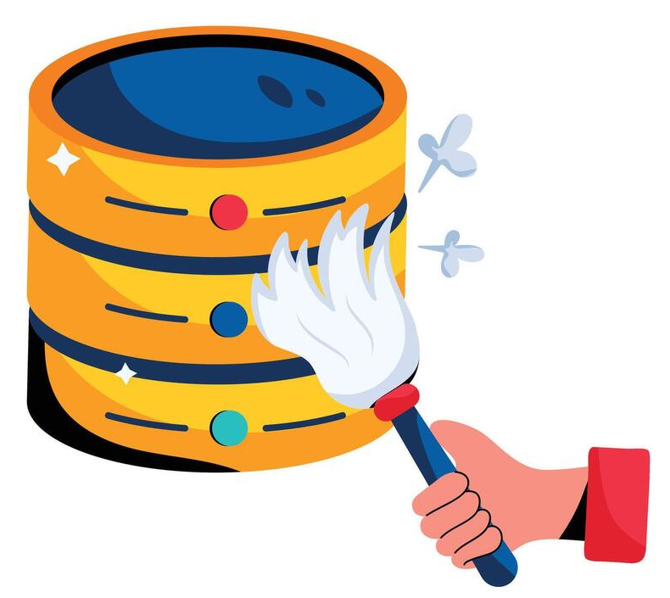
Preparing the Data
Step 1: Loading the Data from Excel
Reading data into a Pandas DataFrame.
Additional sub-steps:
Calculating summary statistics.
Viewing data attributes (columns)
Step 2: Data Preprocessing
Improving data quality for Data Analysis and Machine Learning
Sub-steps:
Checking for missing values.
Checking for duplicates.
Ensuring correct data types of DataFrame columns.
One Hot Encoding

Slide 8
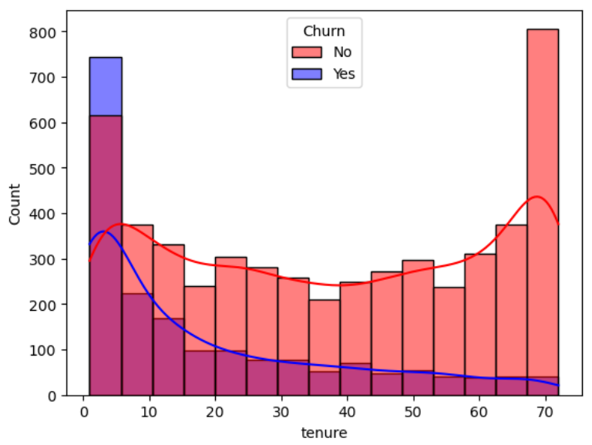
Exploratory Data Analysis
Step 3: Exploring the Data
Sub-steps:
Re-calculating summary statistics.
Descriptive statistics of categorical data.
Visualizing Data to answer business questions like:
What factors are causing customers to churn?
Why customers might stay with the company (retention)?

Slide 9
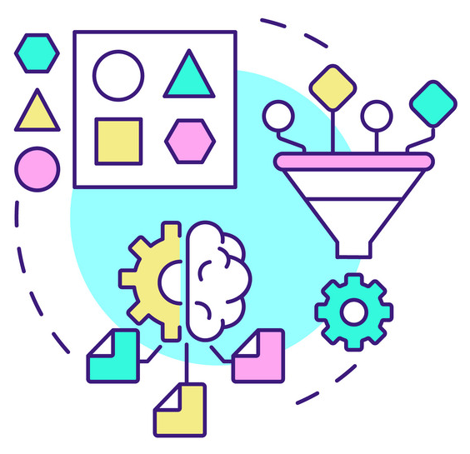
Further Preparation for Machine Learning
Step 4: Feature Engineering
Creating additional features for improving predictions.
Additional sub-steps:
Polynomial Feature Generation
Step 5: Feature Importance
Checking significance of the feature for machine learning.
Sub-steps:
Use decision tree to calculate feature importance.
Removing features with low significance to predictions.

Slide 10
Module 2: AI Algorithm

Slide 11
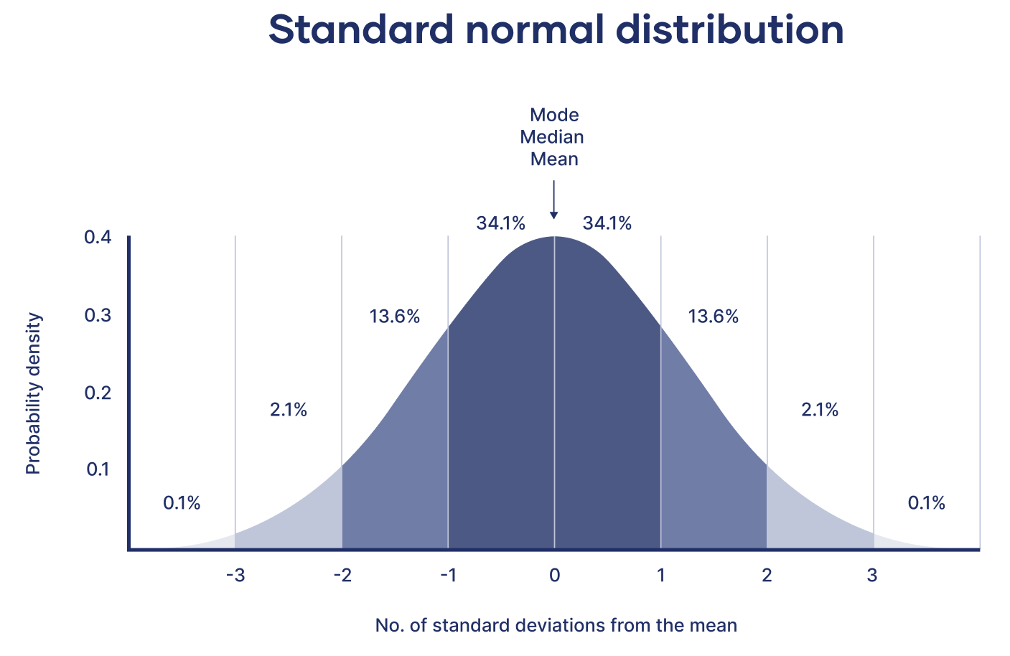
Step 1: Final steps of Data Preparation
Sub-steps:
Split the data into training and testing sets.
Standardization of the Data.
Storing Standard Scaler and Polynomial Features in Pickle files.

Slide 12
Building Models
Step 2: Model Selection
As we are dealing with a classification problem, we will be trying the models for:
Logistic Regression
Decision Trees
Random Forest
Gradient Boosting
Support Vector Machine
Step 3: Model Training and Evaluation
Train the models on the training data and test using testing data.
The measures we will evaluate are:
Accuracy
Precision
Recall
F1
ROC-AUC

Slide 13
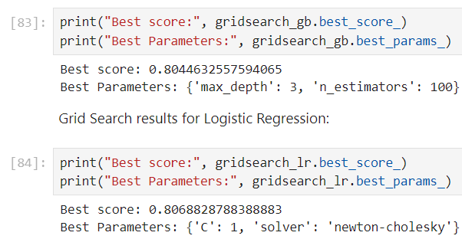
Building Models
Step 4: Cross-Validation
Using K-Fold cross-validation (K = 10) to gain an understanding of which models generally perform better on unseen data.
Models with the best scores in cross-validation and other metrics:
Logistic Regression
Gradient Boosting
Step 5: Hyper-Parameter Tuning
Grid Search is performed to find better hyperparameters for these two models.
Repeat calculation of scores:

Slide 14
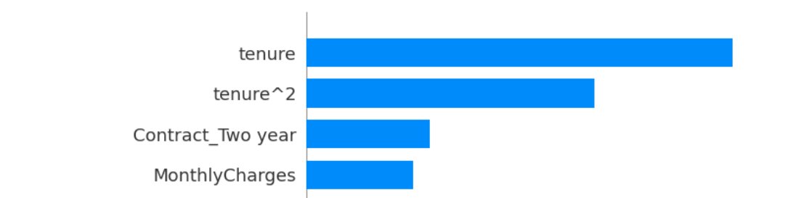
Selecting our Final Model
Step 7: Model Interpretation
Using SHapely Additive eXplanations (SHAP) values to see which features are valued by the model most.
Step 6: Choosing the Model with the Best Score
Logistic Regression is chosen as our main model for use in the Web Application and API.
Step 8: Choosing the Model with the Best Score
Storing the model in a Pickle file for future use.

Slide 15
Module 3: SQL

Slide 16
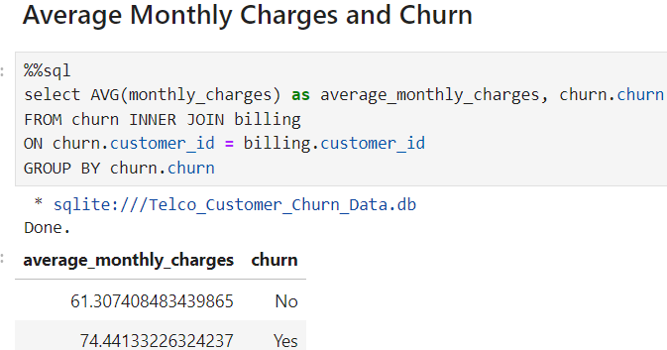
Building a Database and Querying
Step 1: Building a Database in SQLite
Designing a schema and implementing it in SQLite.
Moving data from Pandas to the database.
Tables for customers, services, contract, billing, and churn/prediction.
Step 2: Querying and Investigating
Running simple and advanced queries on the database to figure out any unnoticed trends.

Slide 17
Module 4: Model Deployment and API Consumption

Slide 18
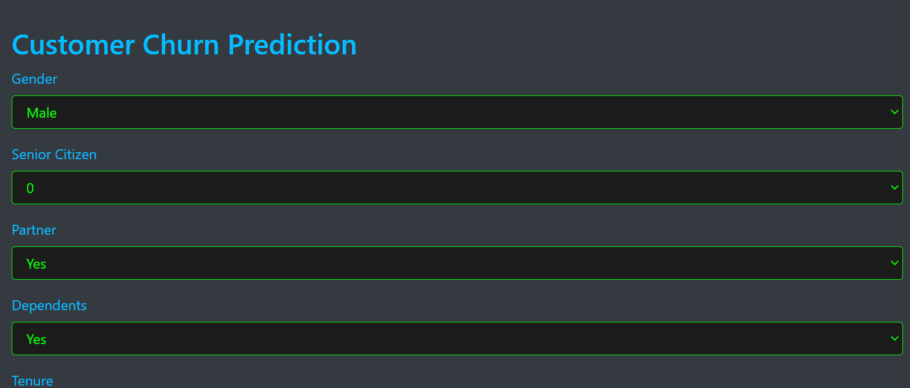
Building a Web Application and its API
Step 1: API Development
Develop an API and expose its endpoints:
/healthcheck: Used to test API using GET request.
/predict: You can get customer churn predictions by using POST.
Step 3: API Testing
Ensuring API functionality using Postman.
Step 2: Web Application Development
Preparing the front-end and launching the web application.

Slide 19
Conclusion

Slide 20
Findings
A number of interesting patterns revealed themselves. The following customers were more likely to churn:
Customers with higher monthly charges.
Customers who purchased a month-to-month contract.
Customers using fiber optic over DSL.
Customers that had been with the service for approx 30 months (2.5 years) or less.

Slide 21
Suggestions for the Future
A few ways we may reduce churn:
Reducing monthly charges or offering discount offers.
Promoting more towards larger families.
DSL in smaller communities (fewer internet requirements).
Fiber for larger communities (more internet requirements).

Slide 22
Thank You for making it to the end.

